Slide 1


FED TAPERING
RAJIV GANDHI EQUITY SAVINGS SCHEME

Slide 2

Understanding
Rajiv Gandhi Equity Savings Scheme (RGESS)

Slide 3

RAJIV GANDHI EQUITY SAVINGS SCHEME (RGESS)
Rajiv Gandhi Equity Saving Scheme (RGESS) is a tax-saving instrument announced in the Finance Act, 2012 to attract new investors to the equity market.
It is exclusively for first time retail investors in the securities market. These investors are called “NEW INVESTORS”.

Slide 4
RAJIV GANDHI EQUITY SAVINGS SCHEME (RGESS)
But did you know that you may have invested in equity mutual funds earlier, but are still a
“new investor” as far as RGESS is concerned?
Or you may hold physical shares but would still be considered as a first-time investor in equity markets.

Slide 5
Confused?
Let’s try and understand few things about RGESS in the next slide.

Slide 6

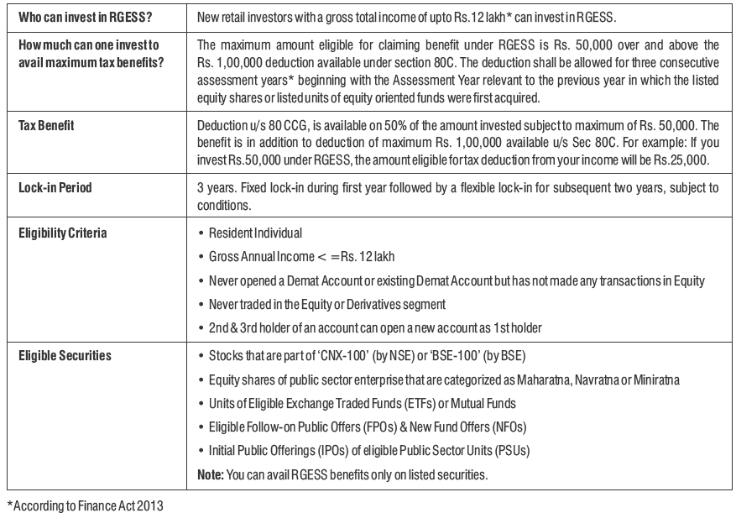
RAJIV GANDHI EQUITY SAVINGS SCHEME (RGESS)

Slide 7
Let us understand this better by using four different scenarios.

Slide 8
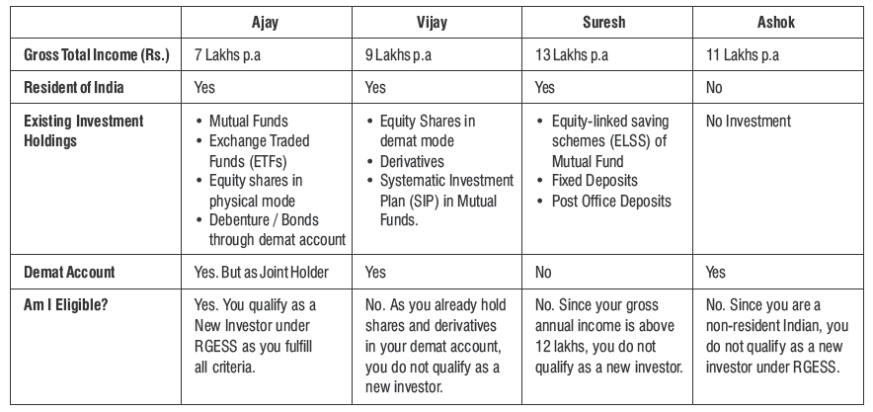
RAJIV GANDHI EQUITY SAVINGS SCHEME (RGESS)

Slide 9

RAJIV GANDHI EQUITY SAVINGS SCHEME (RGESS)
So, how is RGESS different from ELSS schemes of Mutual Funds?

Slide 10
RAJIV GANDHI EQUITY SAVINGS SCHEME (RGESS)
ELSS and RGESS are entirely different schemes. ELSS is meant for indirect participation in the stock market, whereas RGESS aims to encourage direct participation in the stock market. The operational differences are given in the next slide.

Slide 11
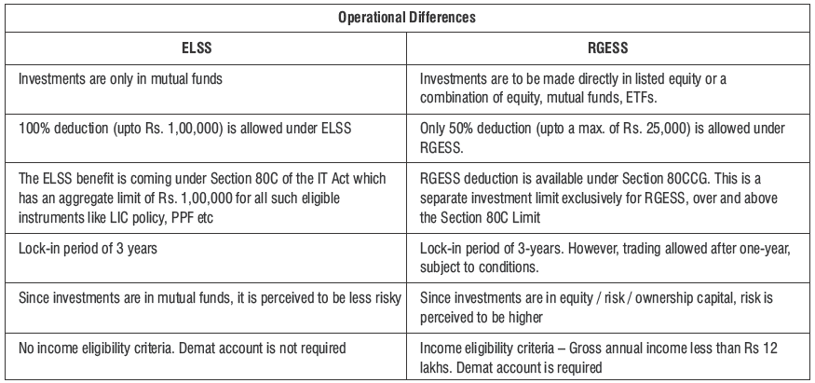
RAJIV GANDHI EQUITY SAVINGS SCHEME (RGESS)

Slide 12
RAJIV GANDHI EQUITY SAVINGS SCHEME (RGESS)
What are Forms A and B?
Form A is what you need to fill and give your depository participant before you make your first RGESS investment. This form will certify that you are, indeed, a first-time investor and are eligible to invest in an RGESS.

Slide 13
RAJIV GANDHI EQUITY SAVINGS SCHEME (RGESS)
If you buy any RGESS-eligible security, within the overall investment limit of Rs.50,000, but don’t want it to be counted as an RGESS investment, then you need to give form B. This would mean that you can sell this security anytime you want and not be subject to the lock-in of three years.
Needless to say you then do not get to avail of the tax benefits either.

Slide 14
RAJIV GANDHI EQUITY SAVINGS SCHEME (RGESS)
However, if you buy an RGESS-eligible security beyond
your Rs. 50,000 limit, don’t bother giving any form then
it will automatically not be counted as RGESS-eligible.

Slide 15
RAJIV GANDHI EQUITY SAVINGS SCHEME (RGESS)
Hope you have understood
the nitty-gritty of RGESS.

Slide 16
Please give us your feedback at
professor@tataamc.com

Slide 17

DISCLAIMER
The views expressed in this lesson are for information purposes only and do not construe to be any investment, legal or taxation advice. The lesson is a conceptual representation and may not include several nuances that are associated and vital. The purpose of this lesson is to clarify the basics of the concept so that readers at large can relate and thereby take more interest in the product / concept. In a nutshell, Professor Simply Simple lessons should be seen from the perspective of it being a primer on financial concepts. The contents are topical in nature and held true at the time of creation of the lesson. This is not indicative of future market trends, nor is Tata Asset Management Ltd. attempting to predict the same. Reprinting any part of this material will be at your own risk. Tata Asset Management Ltd. will not be liable for the consequences of such action.
Mutual Fund investments are subject to market risks,
read all scheme related documents carefully.

